Slide 1
Marketing Science:
Grocery and Data Analytics
Presentation Group 3: Tania Turdean, Mihnea Macovei, Giulia Zhang, Jack Lim, Ninon Lavolle, Gauri Munjal and Thais Parisot

Slide 2
Industry background and Research Questions
In the U.S., many grocery retailers are experiencing falling gross margins due to three major forces:
consumers’ changing preferences,
intensifying competition, and
new technologies.
Our report analyzes Dunnhumby’ grocery data and proposes a set of informed-marketing strategies to help U.S. grocery retailers navigate industry change and achieve profitable growth.
Research Questions:
PRICING
Do U.S. retailers price discriminate based on geographical region (States and Cities)?
Is this explained by price elasticity?
PROMOTION
What is the most efficient type of promotion ?
How can we target customers based on the store price tiers, states and cities in the U.S.?
Is there a correlation between geographical position and TE?
How can we target based on the interaction between those?
Which targeting strategy (if any) is the best? (compared to non-targeting)

Slide 3
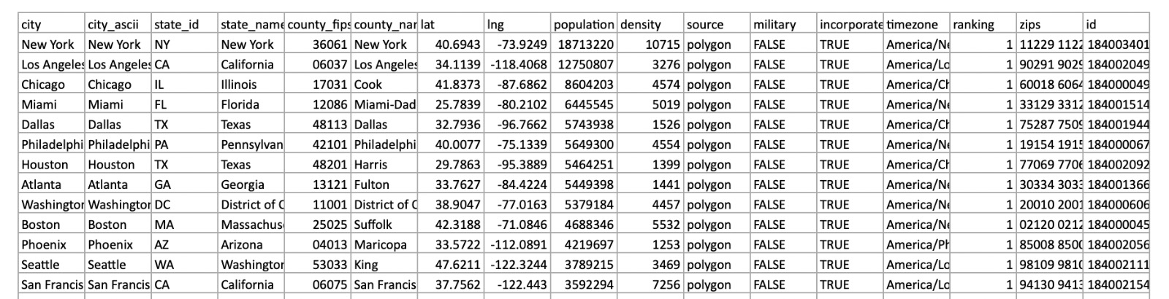
Summary of data sources
Dunnhumby data
It consists of sales and promotional information from a sample of stores, starting from January 2009 to January 2012.
It presents 5 products from each of the 3 major brands in 4 selected categories: frozen pizza, pretzels, cold cereal and mouthwash.
Data was collected from stores in Kentucky, Ohio, Texas and Indiana.
We only focus on cold cereal (highest number of observations 169,686 ) for promotions.
The Dunnhumby data comes in 3 individual Excel files:
Transaction: weekly grocery transactions
Store: geographical and store data
Products: description of products
We merged them using UPC and STORE ID
For price analysis, we selected a single UPC.(Quaker Life Original)
u.s. Cities Dataset
It contains the coordinates of all the cities in the United States, which helped us find the coordinates for the cities in Dunnhumby data by performing a left join.
We disregarded the other columns and merged by state and city with Dunnhumby.

Slide 4
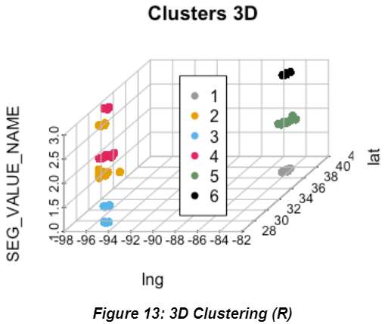
Favourite Graph
Background: Q1
What is the most effective promotion type applied alone?
Most effective type of promotion (applied individually) based on treatment effect of promotions- Feature
Feature = product was in-store circular
Question answered: Q4
How can we target the feature promotion based on the interaction between geographical position and store price tier?
Created a 3D K-means cluster (k=6)
Cluster on 3 variables (store price tier and coordinates of the cities)
We measured treatment effect on both sales and revenue
Highest treatment effect - Cluster 6 (Upscale stores located in Indiana, Ohio, Kentucky)
Indiana, Ohio, Kentucky
Texas
Legend: Seg_value_name = Store Price Tier
1 = Value
2 = Mainstream
3 = Upscale

Slide 5
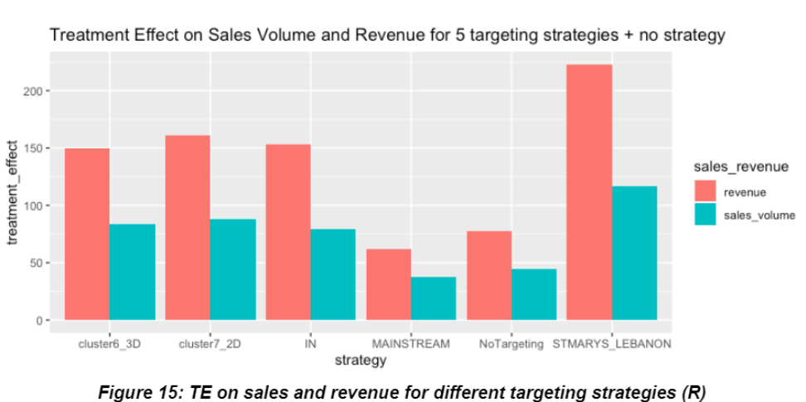
Favourite Managerial Insight
Question answered: Q5
Which targeting strategy (if any) is the best compared to no targeting for feature promotion?
Comparison between all five potential targeting strategies on promotion that we have identified vs. no targeting
Highest TE of Feature = Saint Marys and Lebanon
Recommendation: Grocery retailers should target these cities for achieving the greatest result from the FEATURE promotion strategy

